Slide 1


Cherry Class – Meet the Teacher

Slide 2

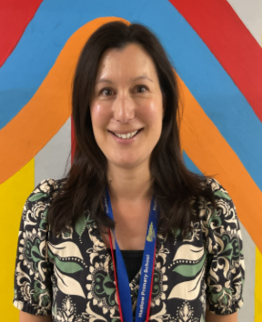
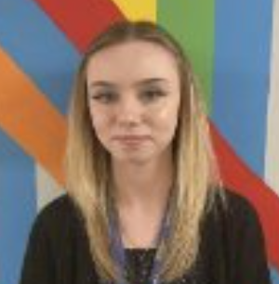

Meet the Team
1-1 Teaching Assistants
Class Teacher
Mrs. Whapshott
Miss Cummings
Mrs. Hood
Teaching Assistant
Mrs. Worsell

Slide 3


A Typical Day
8:45 – 9:00 Registration
9:00 – 9:15 GPS Retrieval
9:30 – 9:45 Daily Mile
9:45 – 10:30 English
10:30 – 10:45 Break Time
10:45 – 11:05 Jungle Spellings and Phonics
11:05 – 12:05 Maths
12:05 – 12:55 Lunch
12:55 – 1:05 Relaxation/Peer Massage
1:05 – 1:30 Guided Reading
1:30 – 1:45 Retrieval
1:45- 2:00 Handwriting
2:00 – 3:00 Science/Geography/PE (Topic subject)
3:00 - 3:20 Story Time

Slide 4



Our Curriculum – Autumn Term
Term 1
Maths – Place Value , Addition and Subtraction
English – The Power of Pictures
Geography – Our World, our home.
looking at Hadlow with a case study on London
Science – Uses of everyday materials
Art – Exploring mixing secondary colours with a case study on George Seurat.

Slide 5



Home Learning
Reading with your child every evening is essential for their development and for them to be able to access all subjects
All home learning including spellings will be on the website under the ‘Home Learning’ icon
Home Learning and Spellings

Slide 6

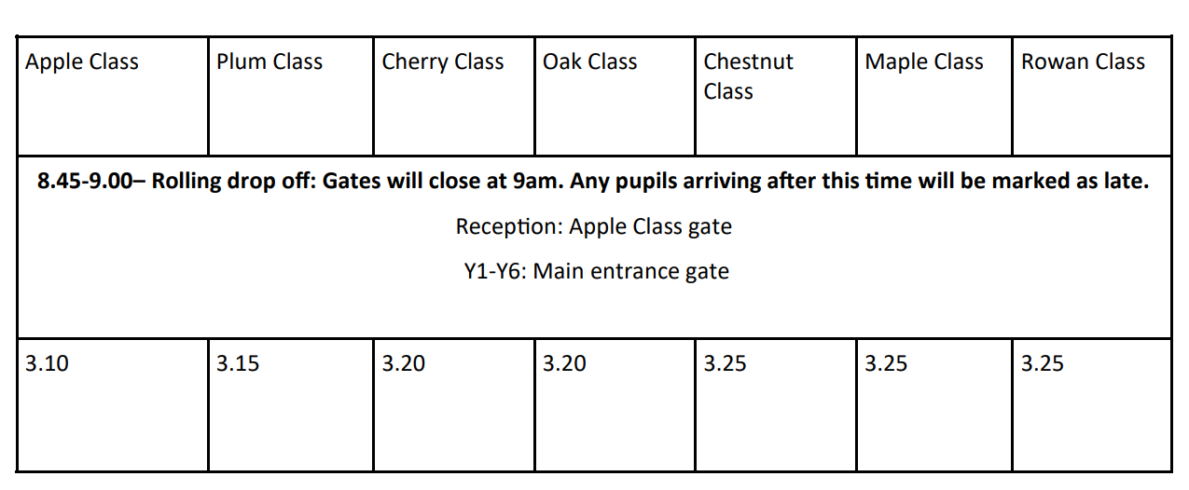

Key Information
PE Days
Term Dates for Term 1
Mondays & Wednesdays
Children will come home on Wednesday wearing their PE kit – back to school for Monday please.

Slide 7



Drop Off
Messages
We may not always have time to chat on the door as we are settling the children and getting them ready to learn.
Any urgent messages can be emailed to the office or passed on to the staff member on the school gate, who will happily pass them on.
Rolling drop off from 8:45 – 9:00
Gates will close at 9:00
Enter at the main gate of the school car park
Leave out of the Blue Gate by the alley.
If you have any messages, please write it in your child’s reading diary, email the class email, or let the office know.

Slide 8
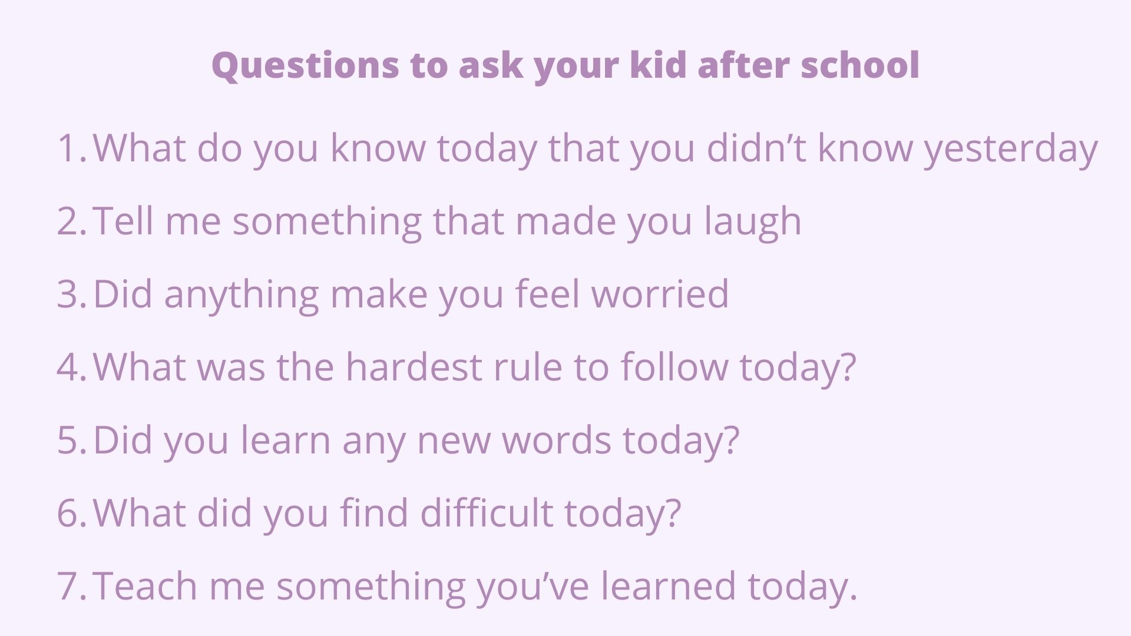

Pick Up
Pick up time is at 3:20
If another relative or school parent will be regularly picking up on your behalf, please email the class team at the beginning of the term so that they are aware and know to expect them.
However, please continue to advise the office of any last minute changes to who is picking up your child.
Picking up Guardians

Slide 9


Food Glorious Food
We strongly advise all pupils in EYFS and KS1 to have a school dinner. This is FREE and ensures that your child gets a fresh, healthy meal every single day.
A meat or vegetarian option (Meatfree Mondays)
Jacket potato,
Pasta
Baguette option (Summer only).
As well as an additional fresh self-service salad bar, which children can help themselves.
So many choices daily!

Slide 10



Medication
Asthma Inhalers
Parents must update all asthma plans and check pumps and spacers.
Medication
All medicines will need to be signed in by parents, with written consent given for administration
Please ensure that all prescribed routine medicine, including for children with allergies, is in date and in school ready for September 2025 (tomorrow)

Slide 11
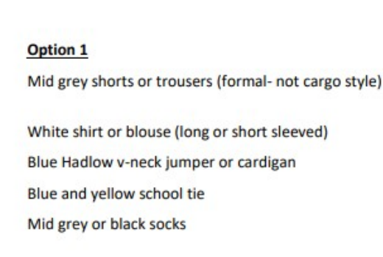

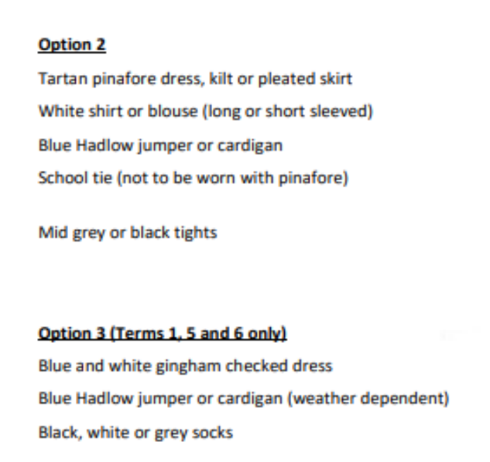

Uniform
PTA have an online pre-loved uniform shop
Bespoke Hadlow uniform items are stocked by Monkhouse only.

Slide 12

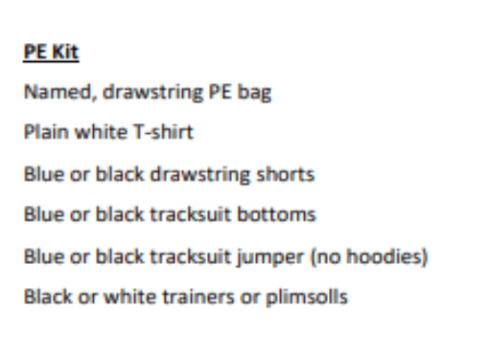


Uniform – PE Kits

Slide 13


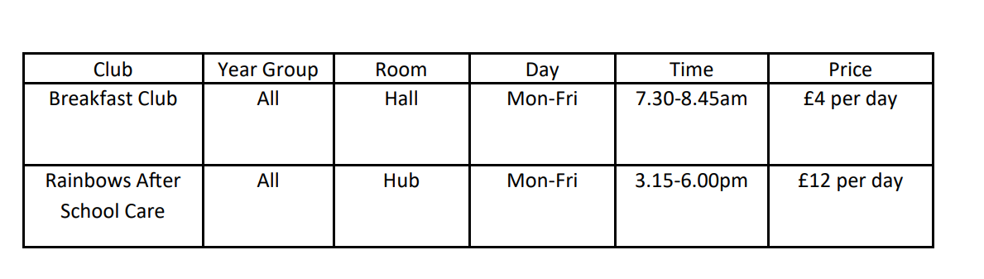

Clubs
We are hoping to launch all co-curricular clubs from Monday 8th September
Sign up forms and payments required will come via ParentMail.
Clubs are on a first come, first served basis and club protocols must be followed at all times to maintain your child’s space.

Slide 14

Parent Partnership

Slide 15

Our Successful Values and Rules
Our Values
Our Rules

Slide 16


Any Questions?

Slide 17
Contact Details
Class Email:
cherryclass@hadlow.kent.sch.uk
School Number:
01732 850 349

