Slide 1

OAK Class
Meet the Teacher

Slide 2

Meet the Team
Class Teacher
Miss Kettle
Class Teaching Assistant
Mrs Wickenden-Stone
Cover Teacher Assitant
Mrs Chimmalagi (Tuesdays)
oakclass@hadlow.kent.sch.uk
Miss Kettle (or another member of the team) will be available on the door every morning and afternoon if you need to discuss anything. You can also email or call the school office – emails are monitored between 08:00-16:30.
Notes:
Each adult to briefly introduce themselves, their experience in the school and something personal

Slide 3
8.45-9.00- Registration/ EMA
9.00-9.30- PSHE
9.30-9.45 – Daily Mile
9.30-10.30 – English
10.30-10.45- Break Time
10.45-11.15- Guided Reading
11.15-12.05- Maths
12.15-1.10- Lunch Time
1.10-1.25- Peer Massage
1.25-1.45- Jungle Spelling
1.45-2.00- Spellings
2.00-3.00- Foundation Topic
3.00-3.20- Story Time
What a day looks like in Oak Class:

Slide 4
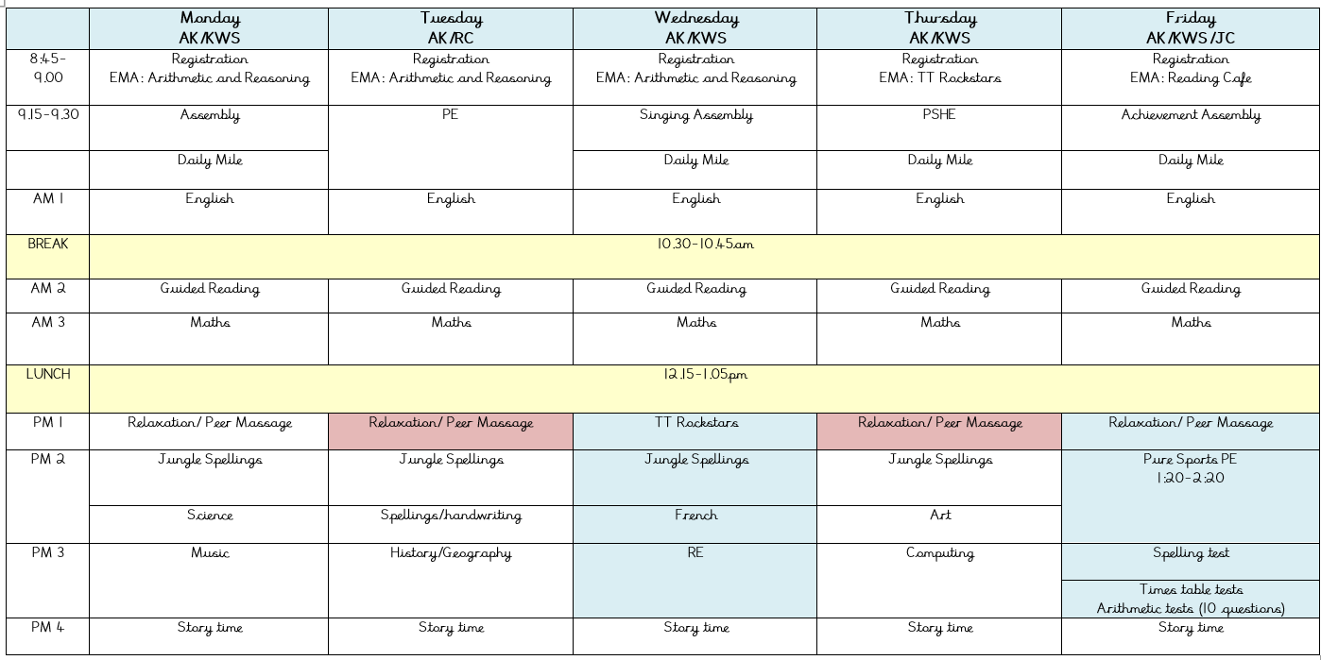
Weekly Timetable
Insert picture of timetable

Slide 5

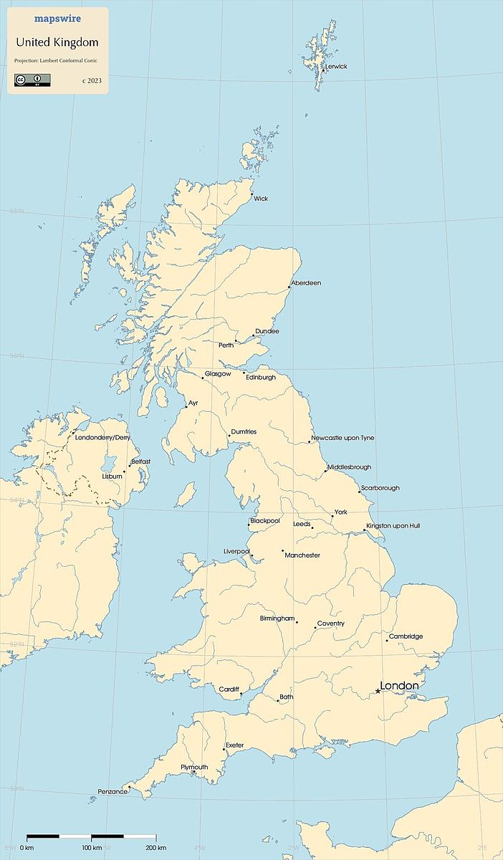
Our Curriculum - Autumn Term
Term 1: The Power of Pictures
Year 3: Our World, Our Home
UK & Tunbridge Wells
Place Value, Addition & Subtraction
Picture Books – Imagination
Animals and Nutrition
Term 2: British Classics
Year 3: Pivotal Periods
British Classics: Iron Man, A Christmas Carol and Shakespeare
Multiplication & Division
The Stone Age
Magnetism and Forces

Slide 6

Key Information- PE Days
This year we are again very lucky to have funding towards our PE curriculum. A specialist coach will join each class once a week to teach certain skills. This will be in addition to another PE session each week led by Miss Kettle.
PE Days
Tuesday AM (Miss Kettle)
Friday PM (Pure Sports)
All jewellery MUST be removed
All children MUST participate in PE- it is a curriculum requirement
All PE kit MUST be named
Records will be kept when children do not have appropriate kit in school

Slide 7



Key Information- Equipment
Full School uniform
Smart school shoes
Named water bottle (avoid disposable bottles)
Named book bag (no Rucksacks)
A waterproof coat
A full PE kit
Wellies for wet days
Hats/scarves/gloves for cold days
Sun cream and hats for hot days
No extra stationery is needed
Notes:
Trainers- shops sell trainer like school shoes, but we will not accept them and children will be asked to remove them
No disposable bottles- environment
We don’t have space to hang up rucksacks
Smiggle- distraction/ arguments etc.

Slide 8

Parents as Partners- Role Models
Always model kindness and respect when talking to the adults. Say good morning. Smile!
Never speak negatively about the school or adults in front of your child- this will have a detrimental effect on their wellbeing.
If you have a problem, come and speak to us or email us! We will always endeavour to listen, deal with the problem and follow up.
Do not deal with things in school, out of school. Leave it to us!
Tell us what we are doing well too! ☺
Notes:
We can only do so much in school, we need a partnership!

Slide 9
Parents as Partners- Safeguarding
Make sure your child gets a good night’s sleep and that they do not have access to screens in their room or one hour before bedtime- research shows this has a negative impact on behaviour, progress, achievement and wellbeing.
Keep them safe online. Keep up to date with new apps and be aware of age limits. Monitor everything. Have an open and honest relationship with technology. Role model safe online behaviour!
If you have any worries about your child’s health or wellbeing, speak to us immediately.

Slide 10
Parents as Partners- Learning
Support your children with reading- this is the single most important skill a child can learn. This must happen 5 times a week and will be monitored.
Support your children with home learning- show them you care!
Support your child with spelling- this is the biggest barrier to writing achievement in our school.
ALL research shows that parental partnership = improved wellbeing and outcomes for children. One childhood. One chance!
If you are struggling to meet this, please speak to one of us as we can provide tips and ways of making this more manageable. We understand it can be very busy as parents!

Slide 11

Parents as Partners- Celebrate Success!
At the end of each school day please ask your child how their day was! There is an opportunity to praise and celebrate every single day.
Attend all special events in school, celebrate your child and their success.
Attend all Child Learning Reviews and Information Evenings- show your child you value their learning.

Slide 12
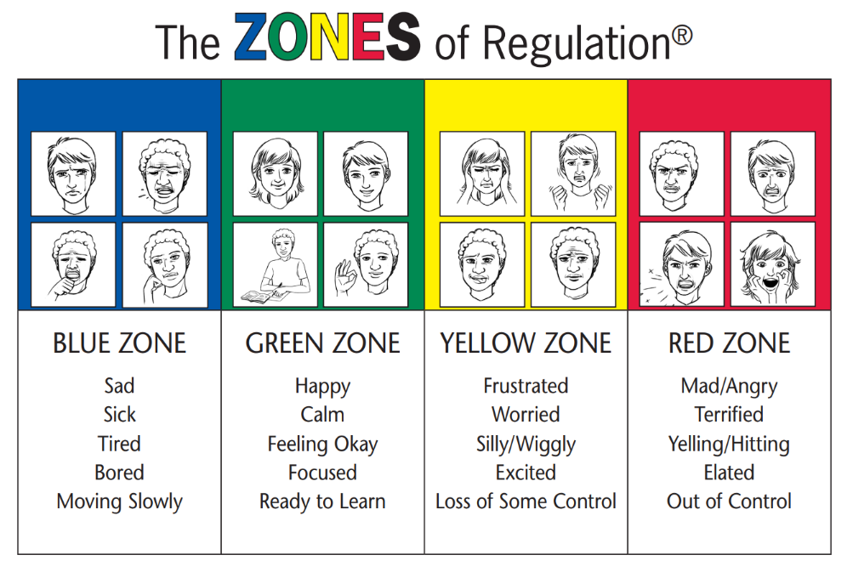
Wellbeing

Slide 13

Behaviour Blueprint
3 school rules – Show Respect and Kindness
                Do Your Best
                Make Good Choices
Whole school approach to fine tuning routines- e.g. beautiful walking
Praise- A well done should be enough… most of the time!
Notes:
Make sure you approach the topic of being good for a reward and the fact that children need to behave well for their wellbeing, not for a gift

Slide 14
Behaviour Blueprint
Step One | Positive reminder/reinforcement | Remind the child that you have faith in them and their abilities. Smile at them. Make them feel valued.
Step Two | De-escalation | Sit and support the child/ Provide further challenge/ Swap their seat/ Give them a job to complete
Step Three | Quiet, supportive chat | Take the child outside/to one side where they are not shamed in front of the class. Tell them that you care about them and their learning and you want to help them to do their best. Discuss ways forward.
Step Four | Reflection Time | Child to sit outside the classroom and reflect on their behaviour (Written reflection for KS2) Have you made good choices? Have you shown care and kindness? Have you tried your best? Time missed out of class will be made up during the following break/lunch time.
Step Five | Communication with Parents | Arrange a same-day phone call or meeting when behaviour continues/ a serious offence happens Following this, a consequence will be shared and discussed with parents.
Notes:
Support us, let us deal with things in school!

