Slide 1

Meet the teacher
Mrs O’Neill

Slide 2
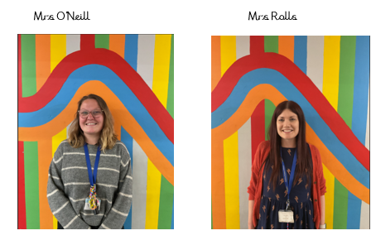
The Chestnut Team
Mrs Adams

Slide 3
My Background
Studied Education (BA Hons) at Greenwich University
During my undergraduate degree I volunteered in many schools, including a Steiner school.
I then became a 1:1 TA to two SEND children.
Achieved QTS in English and Maths.
Completed PGCE at Canterbury Christ Church University.
Been teaching for 7 years.

Slide 4
My teaching style
Calm – I do my best not to yell/ raise my voice
Nurturing – I will always make time to talk to children and listen to them.
Discuss choices: right/ wrong
High expectations – children to work hard and try their best.
Fun, interactive lessons as often as possible.
Learning outdoors, through acting, play and real life.
Mistakes are encouraged – best way to learn
Patient and kind

Slide 5
What are my expectations?
Children to read at least 3-4 times a week.
Times tables practiced at least 4 times a week – TTRS and everyday life.
Homework essentials to be completed
Spelling to be practiced at home whenever possible
Children to be respectful and polite to teachers
Children to come to school with the correct uniform, PE kit, water bottle (filled) and a balanced lunch.

Slide 6
What you can expect from me
To get to know your children, listen to them and help them in every way I can.
Extended/challenge children so that they get all they can from lessons.
Encouragement to reflect on mistakes and learn from them.
Regular communication, but patience would be appreciated because there are very busy times of the day and term.
Homework showcased reading records checked.

Slide 7
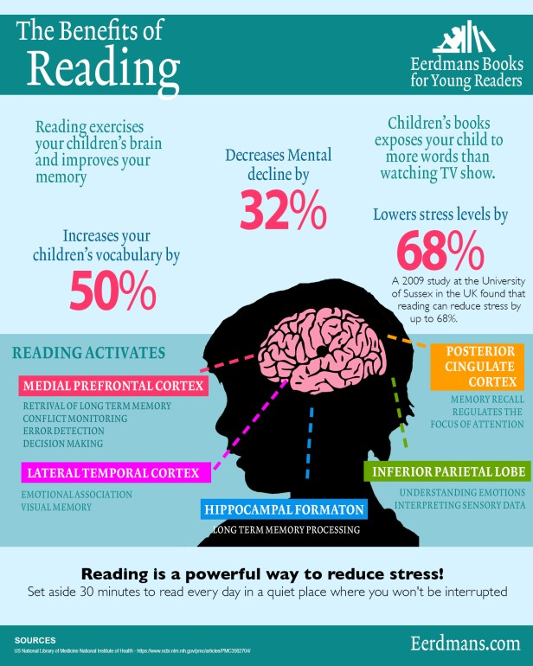
Reading needs to be a priority
Reading expands a child’s vocabulary
Reading helps build independence and self confidence
Reading helps kids make sense of the world
Reading with your kids is great family bonding
Reading is a great entertainment alternative (so long, video games!)
Reading helps kids become better communicators
Reading takes kids places they’ve never been and broadens their horizons
Even if your child is reading chapter books, daily talk and discussion about stories and reading together is one of the best things you can do.

Slide 8
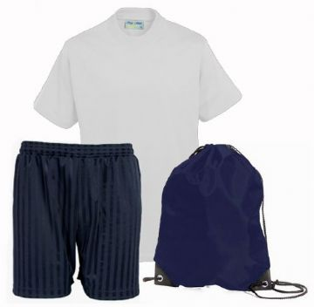
PE days
Monday afternoons
Wednesday Afternoons
PE kit:
Plimsolls and trainers are acceptable
No football kits
Term 4 and 5: Swimming lessons

Slide 9
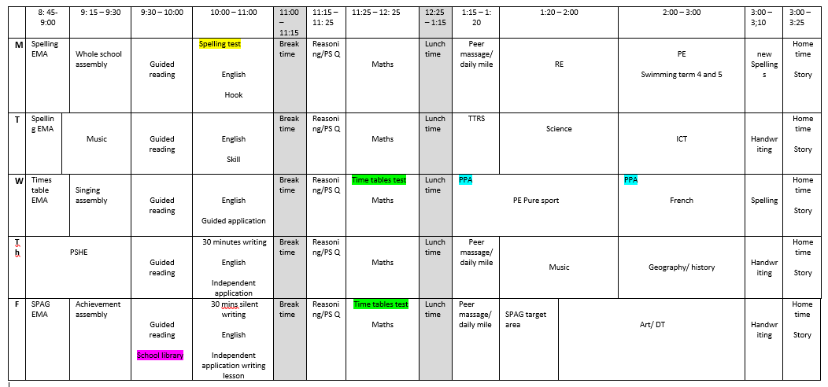

Slide 10
Trips
Termly Trips to cover topics and give the children enriching and exciting experiences, (to be confirmed when finalised), and I will upload onto the website.
Term 1 | Term 2 | Term 3 | Term 4 | Term 5 | Term 6
Rochester – Geography field trip |  |  |  |  | Harry Potter studios

Slide 11

Thank you for coming!

