Slide 1



Plum Class – Meet the Teaching Team

Slide 2

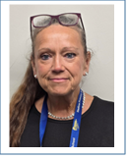
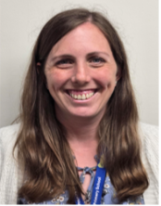
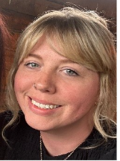
Meet the Team
Class Teacher
SEND Teaching Assistant
Teaching Assistant

Slide 3
Meet the Team
Class Teacher- Mrs Regier
Experience teaching across Years 1-6, since moving to the UK from Cananda 12 years ago
Taught in Year 1 for the past 2 years
I have a passion for reading, and love sharing stories

Slide 4
Meet the Team
Teaching Assistant- Miss Knight
I am new to Hadlow primary school but completed my early years teacher training here earlier this year and I fell in love with the school! I also have a degree in childhood studies.
I have two years experience in a local nursery and worked at a special needs school before having my own children.
I have a 2 year old and a 4 year old who keep me super busy. Family time is my favourite thing.
I have a pet bulldog called Willow and a rabbit called Misty.
In my spare time you’ll probably find me listening to music, being creative, attempting to keep fit or baking.
My favourite movies are Toy Story and Titanic, I enjoy all kinds of music but my fave band is Fleetwood Mac, and my favourite food is anything Italian.

Slide 5
Meet the Team
SEND Teaching Assistant- Mrs Brinkley
- __years experience

Slide 6


A Typical Day
8:45 – 9:00 Registration/EMA activity
9:00 – 9:20 Phonics
9:20 – 9:30 Daily Mile
9:30 – 10:30 Maths
10:30 – 10:45 Break Time
10:45 – 11:05 Shared Reader
11:05 – 12:05 English
12:00 – 12:50 Lunch
12:50 – 1:05 Relaxation/Peer Massage
1:05 – 1:30 Handwriting/Spelling
1:30- 2:15 Music/Computing
2:15 – 3:05 Science/Geography/PE/Art
3:05 - 3:15 Story Time

Slide 7



Our Curriculum – Autumn Term
Term 1
Maths – Place Value , Addition and Subtraction
English – The Power of Pictures
Geography – Our World, our home.
looking at Hadlow and the surrounding area
Science – Seasons
Art – Exploring mixing colours with a case study on Sonya Delaney.

Slide 8
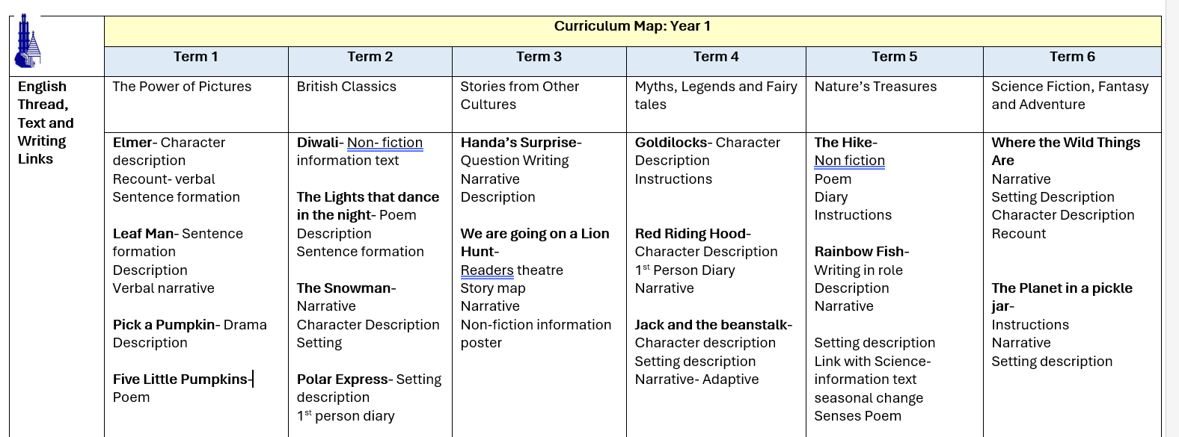


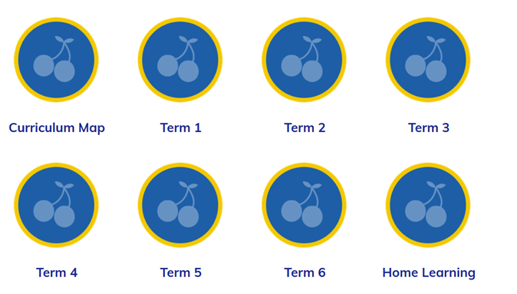
Our Curriculum
Here you can find all the curriculum information for the year.
https://www.hadlow.kent.sch.uk/curriculum-map-1/

Slide 9
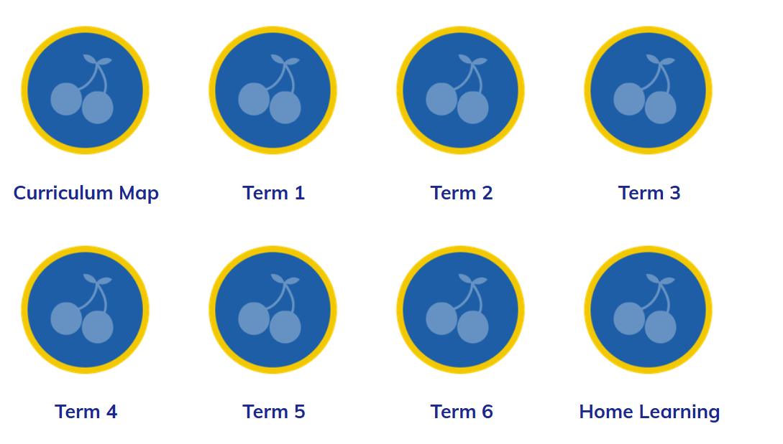
Home Learning
Reading with your child every evening is essential for their development and for them to be able to access all subjects
All home learning including spellings will be on the website under the ‘Home Learning’ icon
Home Learning and Spellings

Slide 10
Website
Class pages on the school website will be updated weekly. Please check regularly to see examples of learning, photographs and special events.
Please also check our school website for any additional school-based information, before contacting the school office.
Click on each term to find up to date photos and examples of learning.
https://hadlowprimary.secure-primarysite.net/classes/

Slide 11


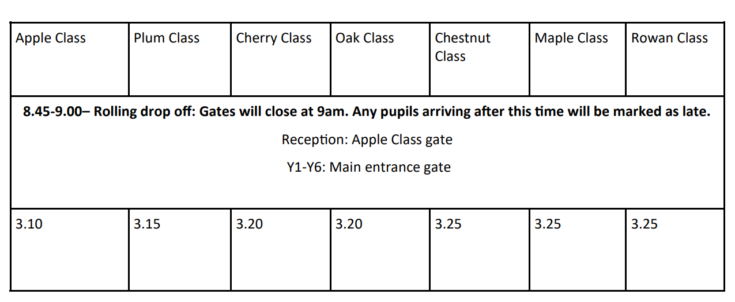



Key Information
Picking up Guardians
If another relative or school parent will be regularly picking up on your behalf, please email the class team at the beginning of the term so that they are aware and know to expect them.
However, please continue to advise the office of any last minute changes to who is picking up your child.

Slide 12
Statutory Assessments
In Year 1, children complete the statutory assessment of Phonics.
The assessment checks the mastery of the GPCs taught in reception and year 1.
The assessment takes place at the beginning of term 6, with regular progress checks each term.
The children will read a mix of real and alien words.
Typically, the pass is 31 or 32 out of 40.

Slide 13



Food Glorious Food
We strongly advise all pupils in EYFS and KS1 to have a school dinner. This is FREE and ensures that your child gets a fresh, healthy meal every single day.
A meat or vegetarian option (Meatfree Mondays)
Jacket potato,
Pasta
Baguette option
As well as an additional fresh self-service salad bar, which children can help themselves.
So many choices daily!

Slide 14



Medication
Asthma Inhalers
Parents must update all asthma plans and check pumps and spacers.
Medication
All medicines will need to be signed in by parents, with written consent given for administration
Please ensure that all prescribed routine medicine, including for children with allergies, is in date and in school ready for September 2026 (tomorrow)

Slide 15
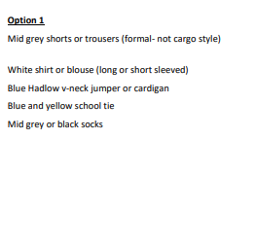
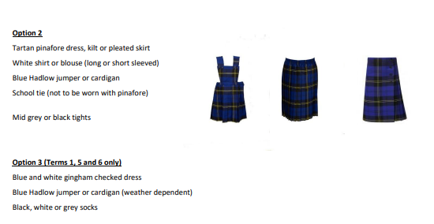
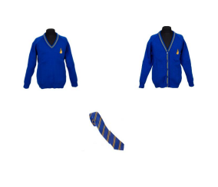
Uniform
PTA have an online pre-loved uniform shop
Bespoke Hadlow uniform items are stocked by Monkhouse only.

Slide 16
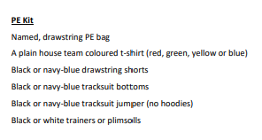

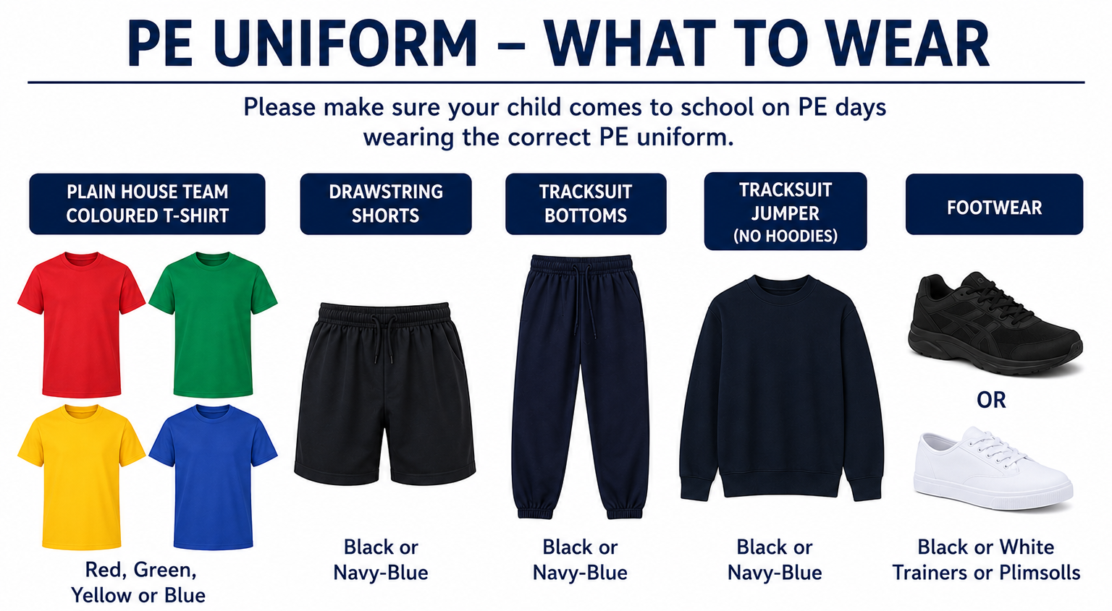

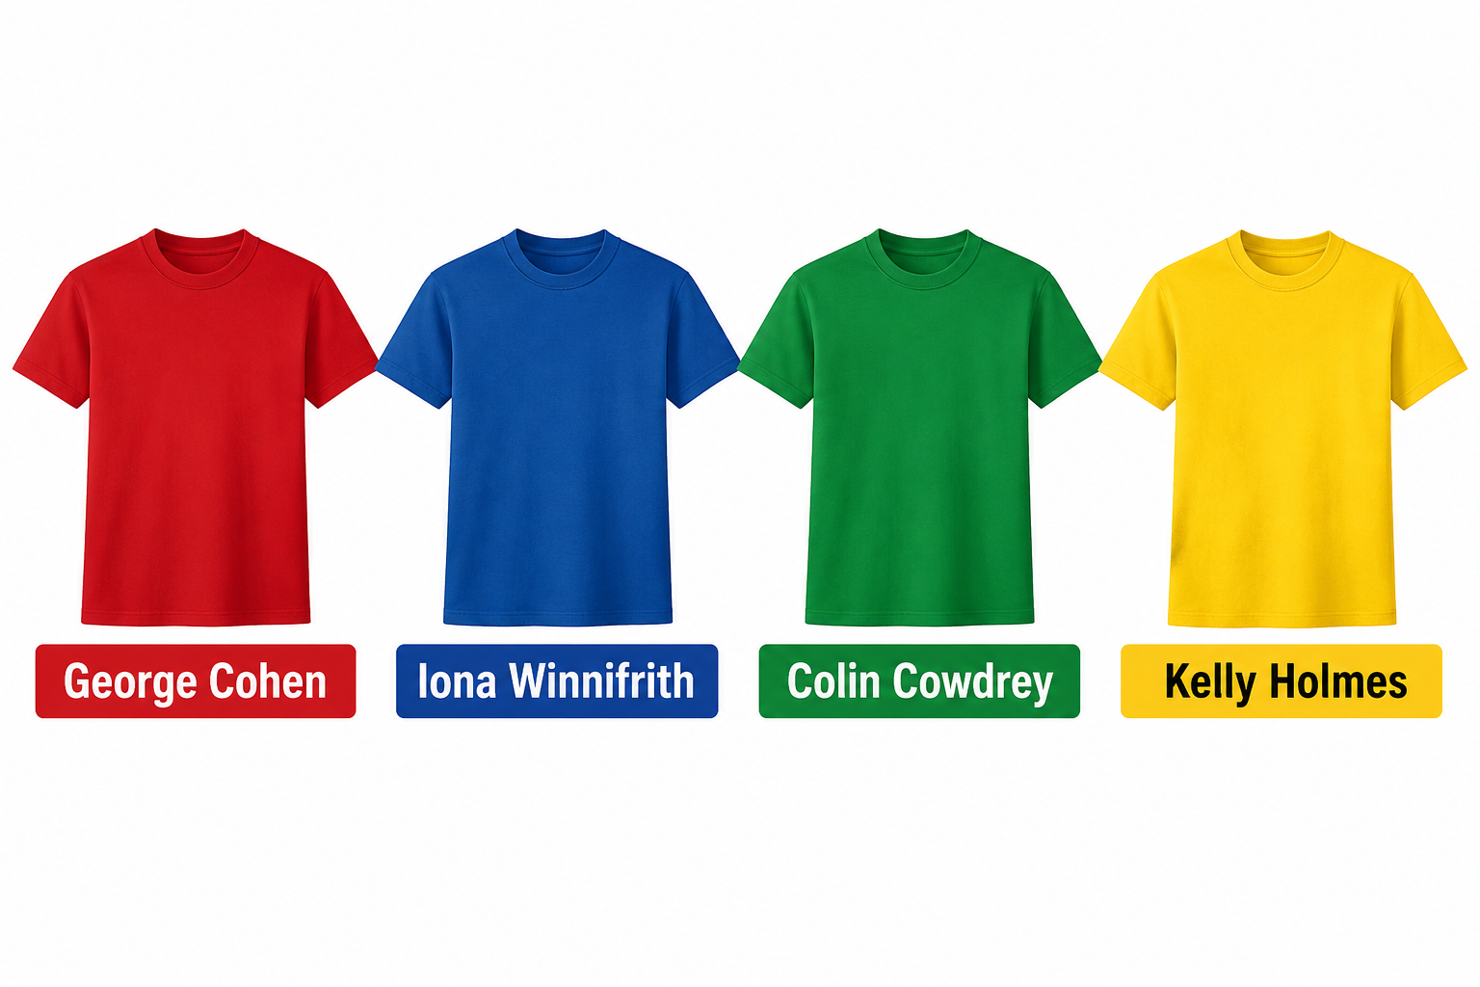
Uniform – PE Kits
Plum Class PE days
Tuesday &Friday
If you're unsure which House Team your child belongs to, please contact their class team.
Partnership Teams 2526.docx

Slide 17
School trips
We are delighted to offer a range of school trips designed to support the children’s personal development. These trips have been carefully planned to enrich the curriculum and provide the children with a wide range of valuable experiences.
Please see the trips and proposed prices below.
Term 1 | Term 2 | Term 3 | Term 4 | Term 5 | Term 6
Walk around Hadlow | Into Film £2 | Corpus Christi | Wingham Wildlife £12 | Leeds Castle £12 | Beach £7.00

Slide 18

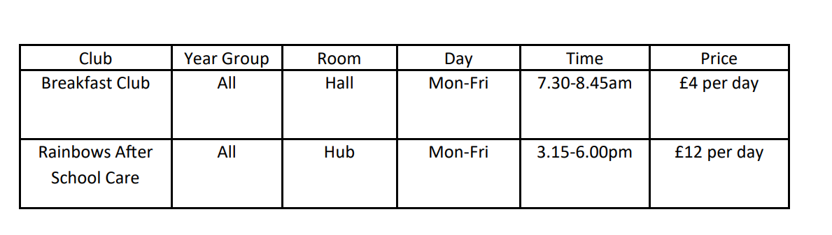

Clubs
We are hoping to launch all co-curricular clubs from Monday 7th September 2026
Sign up forms and payments required will come via ParentMail.
Clubs are on a first come, first served basis and club protocols must be followed at all times to maintain your child’s space.

Slide 19

Mobile Phones
Hadlow is a smartphone free school for all children.
If a phone is needed for contact, it must be a basic or non-smart device. These devices will be kept in a locked safe during the school day.

Slide 20
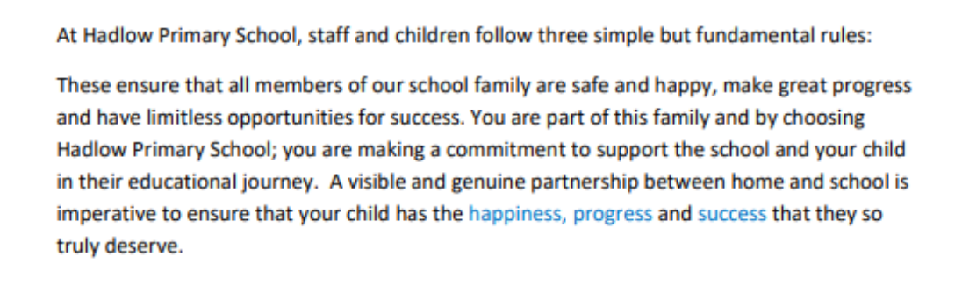
Parent Partnership

Slide 21


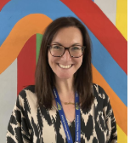
Behaviour Blueprint
At Hadlow, we follow our Behaviour Blueprint, which supports pupils in successfully following the school rules and taking responsibility for their self-regulation and actions.
The children’s wellbeing is at the heart of everything we do. We offer a Nurture Club at lunchtimes and our fabulous Galaxy Room to support children who may find it difficult to regulate their emotions.
Our fantastic Family Liaison Officer (FLO) Mrs Wright is also available to provide support for families during their time at Hadlow School.

Slide 22

Wellbeing- Zones of Regulation
Working alongside the Behaviour Blueprint is Zones of Regulation, which helps children to recognise their emotions and develop strategies to self-regulate.

Slide 23
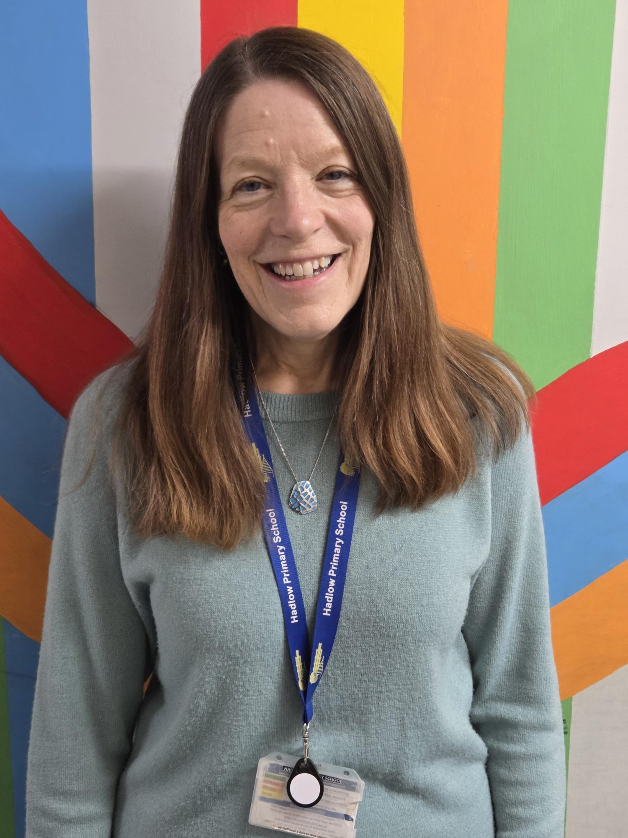
SEND Provision
At Hadlow, we are proud to be an inclusive school, ensuring that every child has access to the right support to help them flourish.
What we offer;
Dedicated SEND Teaching Assistants providing tailored classroom support
Personalised interventions, including small group and 1:1 support
Adapted resources and strategies to meet individual learning needs
Emotional and sensory regulation support where needed
Strong partnerships with families and external professionals
An inclusive, nurturing environment where every child can thrive

Slide 24
School Improvement Plan

Slide 25

Our Successful Values and Rules
Our Values
Our Rules

Slide 26


Any Questions?

Slide 27
Contact Details
Class Email:
plumclass@hadlow.kent.sch.uk
School Number:
01732 850 349

Slide 28





Use this to help shape your PP

