Slide 1
Secondary School Admissions
September 2027
The Kent Test

Slide 2
Who can take the Kent Test?
Children currently in Year 5 who were born between 1 September 2015 and 31 August 2016 can take the Kent Test in 2026.
The test is only valid for Kent grammar schools.
Medway Council has its own Medway Test and London Borough of Bexley has its own Bexley selection test.
Being grammar assessed in the Kent Test does not guarantee your child a place in a Kent grammar school.
Make sure you know where the https://www.kent.gov.uk/__data/assets/pdf_file/0005/196313/Kent-grammar-schools-list.pdf are, and what the admissions criteria are for the school(s) you are interested in. Or search for Kent grammar schools in our Kent schools search.
Many children will find the test difficult. Grammar schools in Kent provide for children in about the top 25% of the ability range.
Children will need support with preparing for the test. Many benefit from a tutor and dedicated, regular practice.
We are unable to prepare and teach to the test within our school day- some aspects of the test are not discreetly covered within the Primary National Curriculum.
There are schemes to support families eligible for free schools meals, with access to free 11+ tutoring. We will make parents aware of anything that becomes available via the school newsletter.

Slide 3
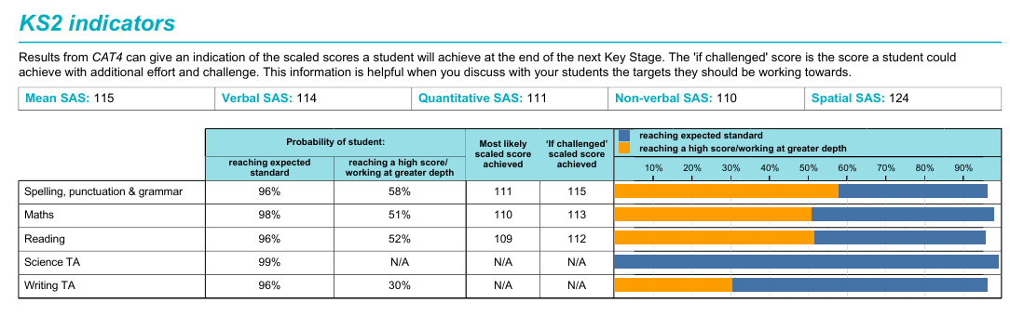
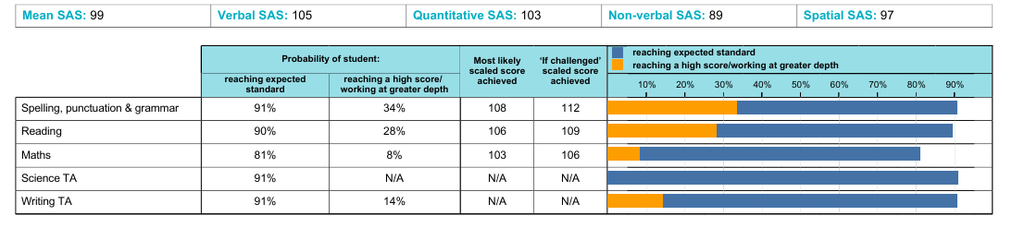
Should my child take the test?
Notes:
CAT4 does not convert into Kent Test scores But: CAT4 around 105–110+ → usually indicates a child can reach 106+ in Kent Test with normal preparation including test practice

Slide 4
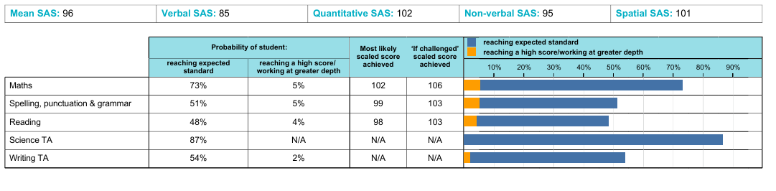

Slide 5
What about pupils with SEND?
If your child has a disability or special educational needs which will affect their access to testing, you need to discuss this with Mrs Vanns (SENCO) before you register them for the test.
The school will then apply for any necessary access arrangements. Requests will not be accepted after 1st July 2026.
The online registration form asks you to confirm that you have discussed a request for access arrangements with the school.
If you would like more information about the special arrangements process, email kent.admissions@kent.gov.uk.
Normal classroom practice:
Smaller group or separate room. Stop the Clock rest breaks. Support of a prompt. Use of specialist equipment. Use of a word processor for the writing task. 25% additional time for the writing task.
Notes:
Is not intended to inflate test results but to enable equal access to test paper by allowing for normal SEND adapted provision.
Special arrangements booklet- to clarify any questions

Slide 6
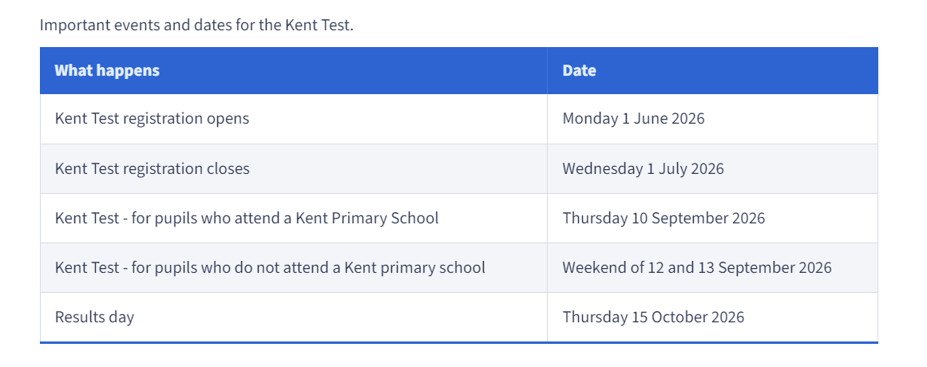
Key Dates:
Any Year 5 pupil who is interested in a Kent grammar school place for September 2027 MUST REGISTER to take part in the September 2026 tests. This includes children with an EHCP Plan.
Deadline for secondary admissions: 31st October 2026

Slide 7

2026 Secondary Admissions
How to register:
You can register your child online using the link below:
https://www.kent.gov.uk/education-and-children/schools/school-places/kent-test/register-for-the-kent-test

Slide 8
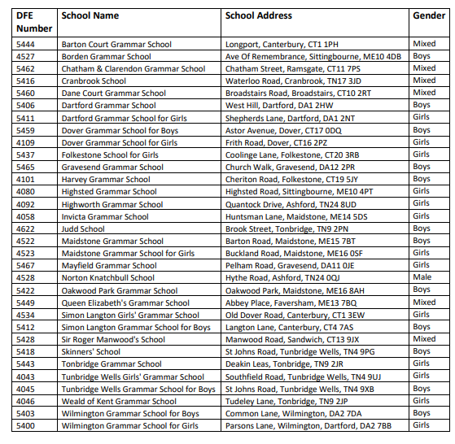
Notes:
32 grammar schools-

Slide 9
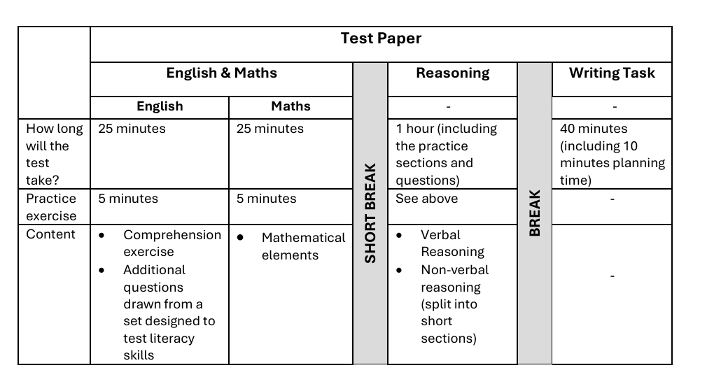
Test Timetable

Slide 10
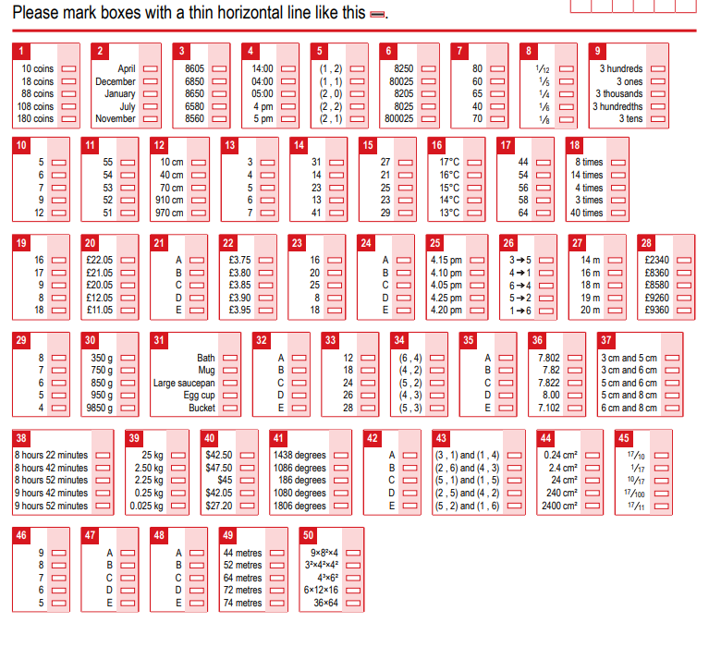
What to expect in the test…
The tests are multiple-choice with a separate answer sheet.
They are marked by a computer.

Slide 11

What to expect in the test…
Test One
The first test will be an English and maths paper and will take 1 hour.
Each section will involve a 5 minute practice exercise followed by a 25 minute test.
The English section will involve a comprehension exercise as well as some additional questions drawn from a set designed to test literacy skills.

Slide 12

What to expect in the test…
Test Two
The second test will be a reasoning paper. It will take about 1 hour, including the practice sections and questions.
It will contain a verbal reasoning section and a non-verbal reasoning section of roughly the same length.
The non-verbal reasoning will be split into short sections, administered and timed individually.

Slide 13

What to expect in the test…
Final Assessment
There will also be a writing exercise which will not be marked but may be used by a local headteacher panel as part of the headteacher assessment stage of the process.
This is for children that do not meet the grammar school requirements, but Headteachers strongly feel the need to appeal the decision.
40 minutes will be allowed for the writing task, including 10 minutes planning time.
Notes:
Children are giving around 5 titles to choose from- covering a range of genres. Poem, story, information, explanation, persuasive etc.

Slide 14
Standardisation and Scores: 2025 (to compare)
Total Score Threshold: To be considered for a grammar school, a child needed to achieve a total score of 332 or higher across all three tests (English, Maths, Reasoning).
Individual Test Score Threshold: No individual test score could be below 106.
Test Score Range: Each test had a score range of 69 to 141.
Highest Possible Score: The maximum possible total score on the Kent Test was 423.
Notes:
Children need to achieve well across all 3 areas (Maths/English/Reasoning) to pass the test and be recommended grammar school.

Slide 15
If your child is assessed as suitable for grammar school
Any Kent grammar school you apply for will consider your application, but this does not guarantee your child will be offered a place.
Grammar schools are often oversubscribed, meaning they receive more applications than there are available places. Schools use their admissions criteria to rank all applicants in priority order, so it’s important to read the admissions criteria for schools you are interested in.
A Kent grammar school can only consider your child for a place if you have named it on your application and your child has been tested and assessed suitable for admission.
If your child is not offered a place at the school, you will be able to appeal to an independent appeal panel and may be able to join the school’s waiting list.
If your child was not tested or was not assessed as suitable for a Kent grammar school
You can still apply for a Kent grammar school but your application to that school will be refused when school places are offered in March 2027.
You will then have the right to appeal to explain why you think it is a suitable option for your child.

Slide 16
Appeals
In Kent, if your child doesn't get a place at a grammar school, you can appeal the decision. There are two main types of appeals: Headteacher Assessments and Parent Appeals.
Headteacher Appeals:
Headteachers have the right to apply for a Headteacher Assessment if a child didn't meet the required standard on the Kent Test.
Headteachers typically receive the test results first and have a short timeframe (usually 48 hours) to decide if any appeals are necessary and gather evidence, which is then delivered to a given address for the appeals panel.
The panel considers the child's workbooks, the Writing Task from the Kent Test, and a report from the headteacher.
If the appeal is successful, the child is considered "selective" and accepted at all Kent grammar schools. If not, parents will not be informed by the LA that an appeal has taken place.
Notes:
Children need to achieve well across all 3 areas (Maths/English/Reasoning) to pass the test and be recommended grammar school.

Slide 17
Appeals
Parent Appeal:
The panel will consider evidence that the child is of grammar school ability, such as school reports, assessments, and references.
You can appeal if you believe the school's admission arrangements were not applied correctly, and if they had been, your child would have been offered a place.
The appeal hearing will be an opportunity to present your case to the panel, and you can attend in person if you wish.
Factors considered in appeals:
Evidence of grammar school ability: This can include past test results, school reports, and references.
Consistency in performance: The panel will want to see evidence of consistent effort and progress.
Reasons for underperformance: You can explain any reasons why your child may have underperformed on the day of the test.
Specific circumstances: If there were any specific disruptions or events that affected your child's performance, this should be mentioned.
Notes:
Children need to achieve well across all 3 areas (Maths/English/Reasoning) to pass the test and be recommended grammar school.

Slide 18
Parental Appeals: Advice
Discuss with your child's teacher/ headteacher whether they support a grammar school place and the likelihood of a successful appeal.  
Name at least one grammar school as a choice but not as your first choice and don’t only name grammar schools as you will not be offered a place at one!  
Prepare yourself and your child for a long waiting game and a period of uncertainty. Appeals can take a long time and can be dependent on subscription, mobility and backlog for individual schools.  
You are appealing directly to the school and their own subscription criteria.
Notes:
Children need to achieve well across all 3 areas (Maths/English/Reasoning) to pass the test and be recommended grammar school.

Slide 19
Free Familiarisation Materials
Familiarisation papers and practice papers each provide useful support when preparing for an 11+ test.
They differ in the following aspects:
Familiarisation papers are free of charge.
They can be downloaded at printed at home. Requests can be made in writing (class email) to print these within school.
It provides general familiarity but does not strictly follow the same format and is not timed.
GL free papers: https://11plus.gl-assessment.co.uk/free-materials/
CPG free papers: https://www.cgpbooks.co.uk/info/preparing-for-the-11-plus-with-cgp/free-11-plus-practice-tests?srsltid=AfmBOopfwZpMhQBzMGd1gHM9KGPpuUKRIMeQpGpNasbY9kdCFAnEgja0
Notes:
Children are giving around 5 titles to choose from- covering a range of genres. Poem, story, information, explanation, persuasive etc.

Slide 20

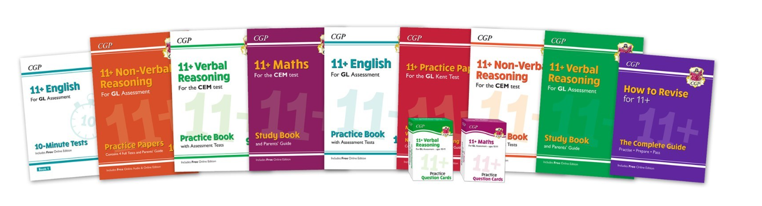
Additional Recommended Resources
GL practice papers
https://11plus.gl-assessment.co.uk/
CPG practice papers
https://www.cgpbooks.co.uk/info/preparing-for-the-11-plus-with-cgp/free-11-plus-practice-tests?srsltid=AfmBOoqBU0zOQ4wfTlhqHkcQQj7Fk4SdysKiVaAynfIfHXoTh2X72NE3

Slide 21
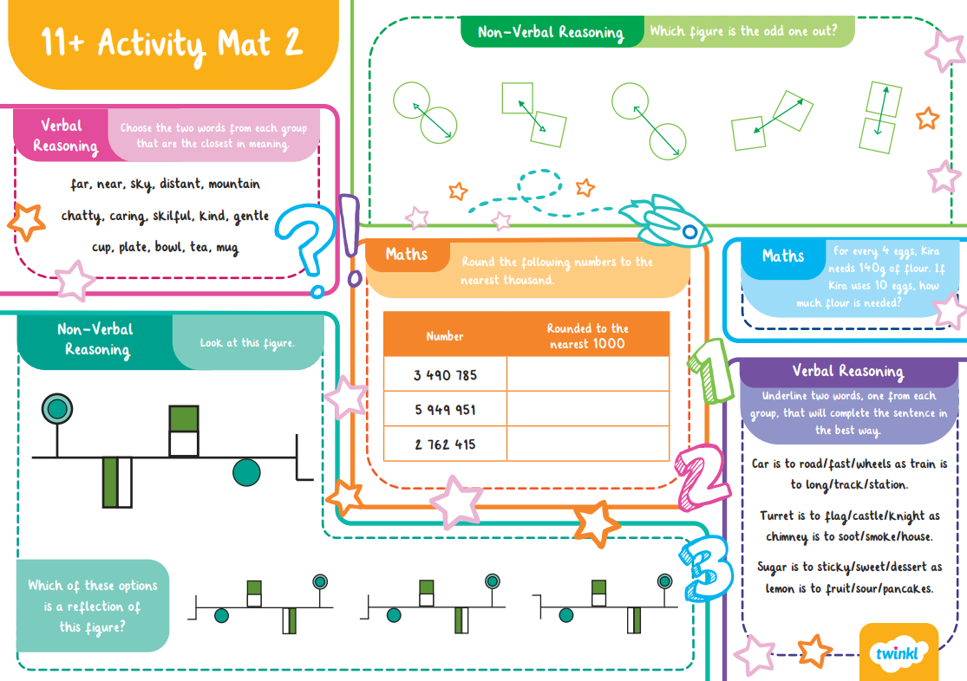
Extra Twinkle Resources
https://www.hadlow.kent.sch.uk/home-learning-10/

Slide 22
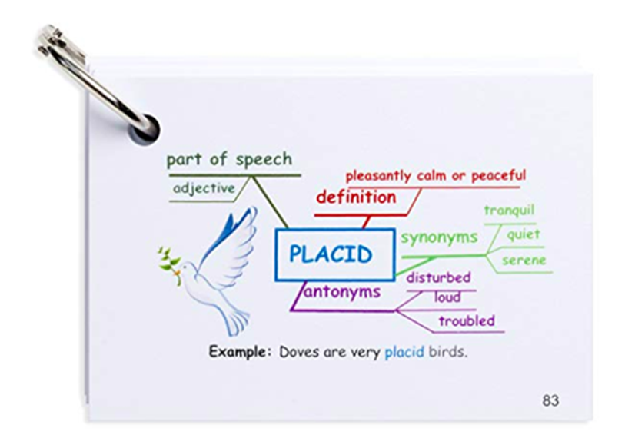
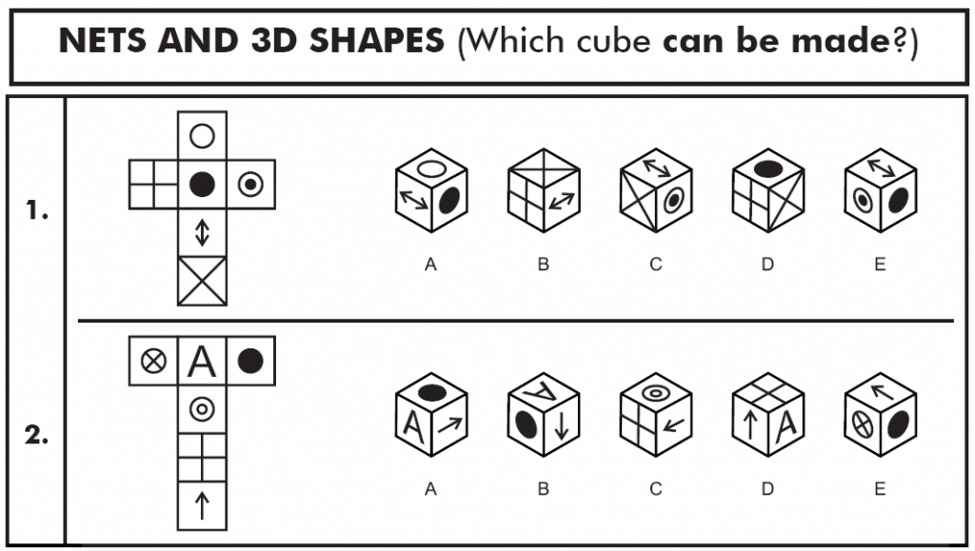
Help you child, work through questions together, show them that you are interested, make it a team effort.
Identify gap and misconceptions – work methodically through all test areas.

Slide 23
Advice from the previous Year 6 pupils:
Practice Makes Perfect - extra work at home is useful but don’t put pressure on yourself!
Have confidence but don’t be over confident.
Don’t panic, always try, reread the question and think about your workings/different strategies.
Try not to waste time – time management is SO important!
Make sure that you talk about any questions, worries or concerns.
It was actually quite a fun day in the end!

Slide 24

Final points
If in doubt, register your child. You can always withdraw them at a later date.
Practice makes perfect- set your child up for success!
If you are unhappy with the results, you do have a right to appeal. Success is rare but possible. More details about the appeal process can be requested at the point of need.

