Slide 1
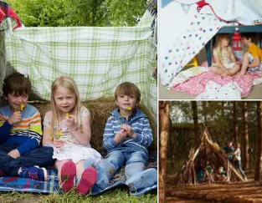
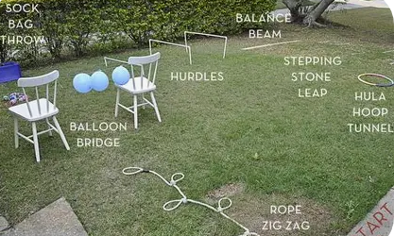
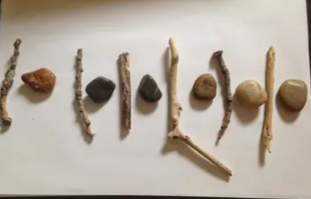
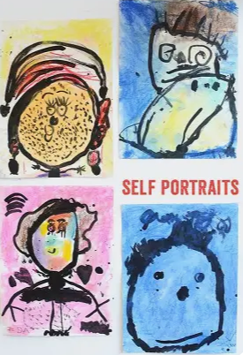
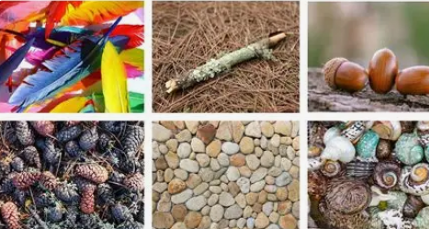
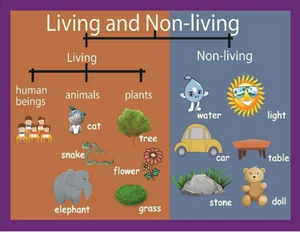

I wonder if you can find natural objects (leaves, sticks, stones, flowers) and use them to create repeating patterns, match similar objects, and group them by size, colour or shape?
Could you build a small den for you and someone special? I wonder if your den will be made inside or outside. Discuss with an adult how you made it.
Can you complete an outdoor obstacle course involving balancing, jumping, crawling and climbing, working on your gross motor skills, balance and co-ordination?
Optional Home Learning Tasks
Can you find items from around you home, inside and out and sort them into living and non-living groups. Discuss why each item belongs in its group and how we care for living things.
Could you collect a few favourite natural objects and use them to tell others about yourself—for example, your
favourite activities or something you enjoy.
Create a self-portrait on the ground, on card or paper, using paint, pencils or natural objects. Talk to your adult about what makes you special.

